Slide 1
Project Nova: Final Model Recommendations
August 26, 2025
Executive Summary:
The baseline model provides a stable return of 12% with moderate risk.
Model performance is highly sensitive to how we handle data outliers; a more aggressive approach could boost returns to 13.5% but also increases risk.
Recommendation: We advise a final validation of the high-return alt_outlier scenario before full implementation.

Slide 2
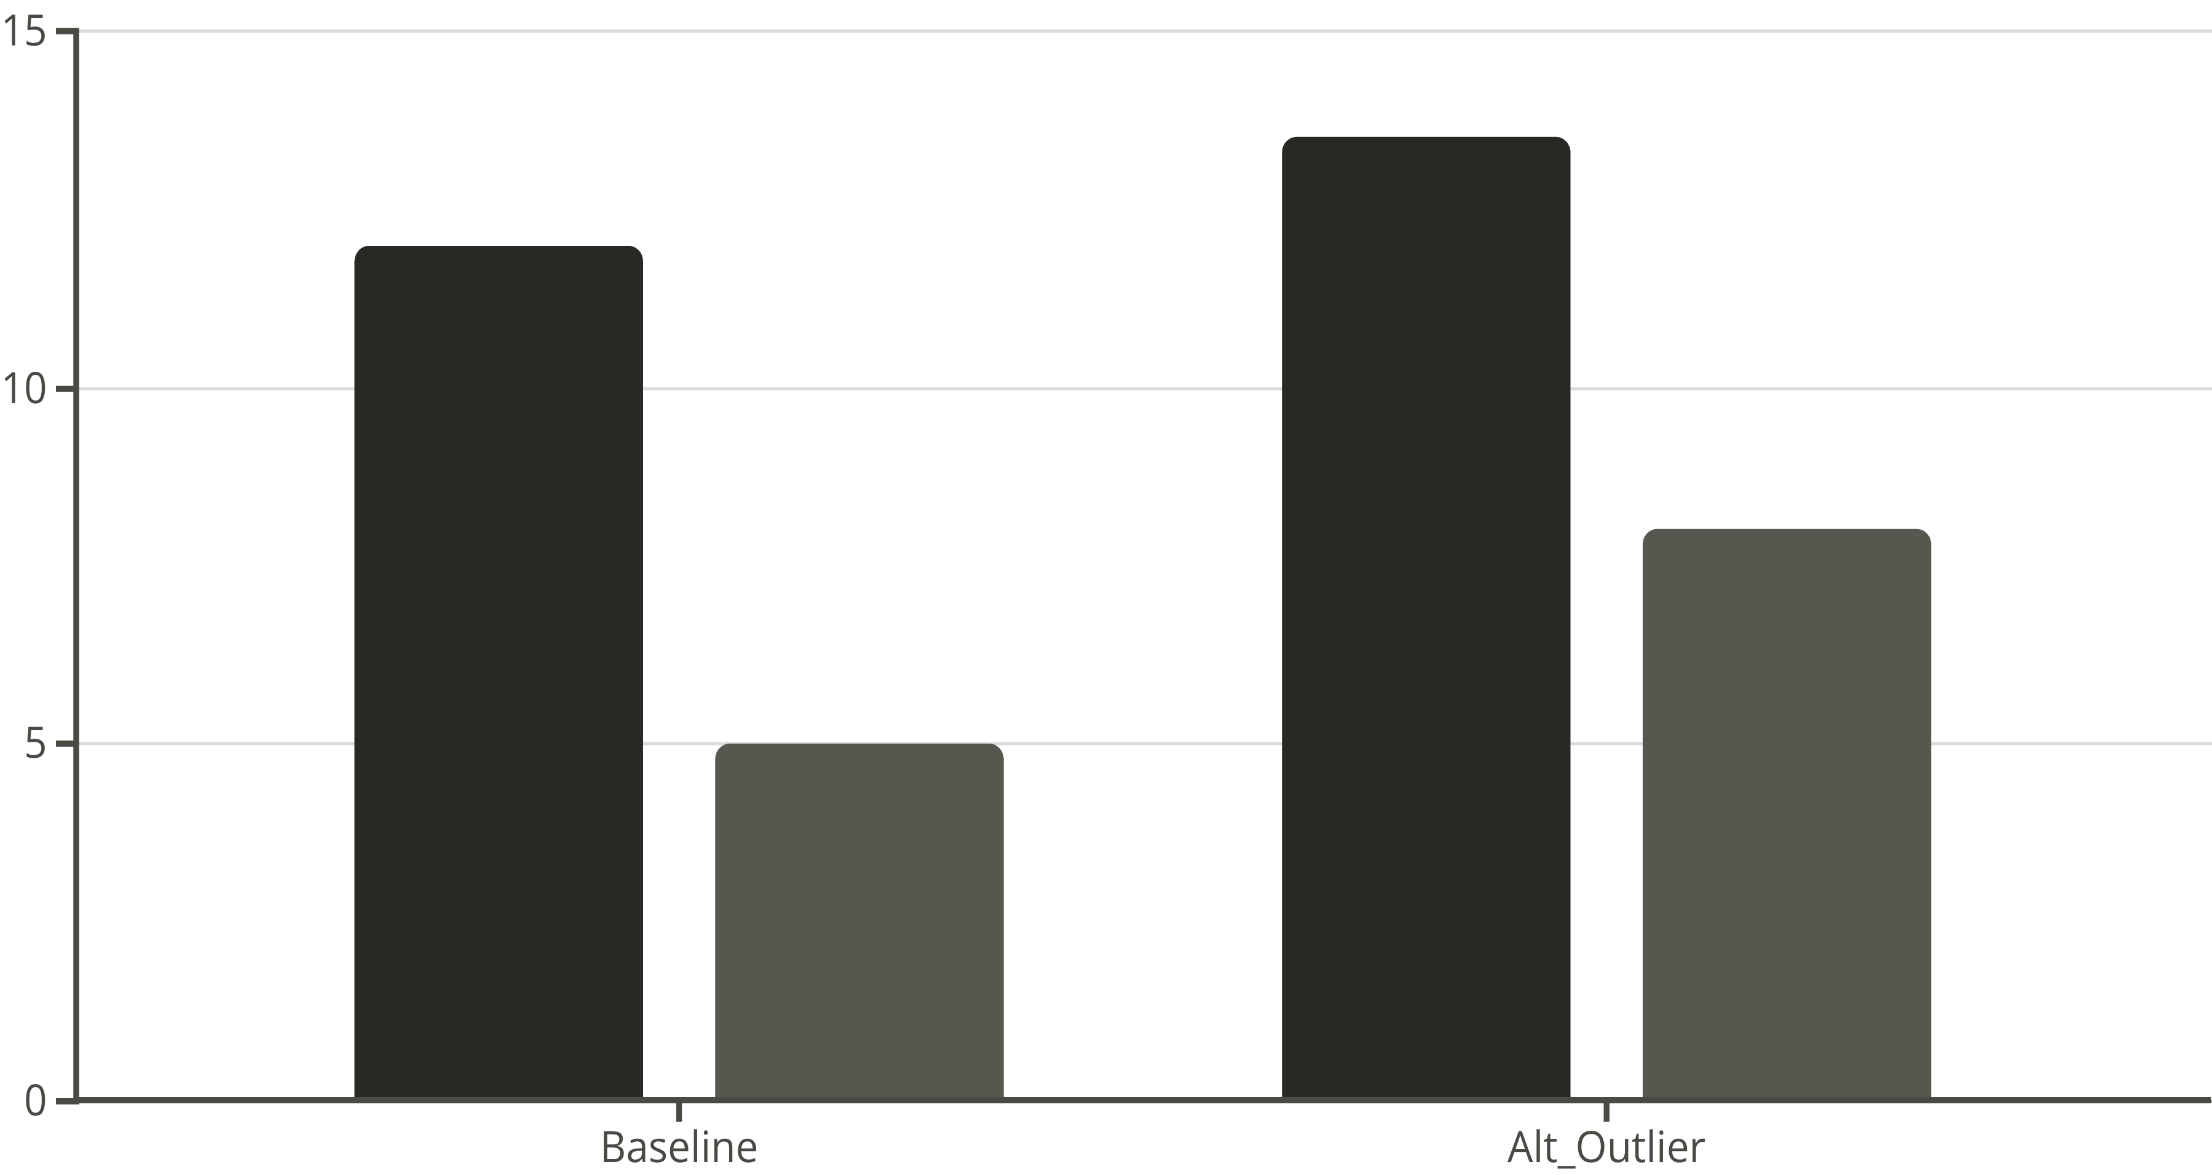
'Alternative Outlier' Scenario Offers Higher Returns at a Higher Risk
Return (%)
Risk (Volatility)
Takeaway:
The chart above maps each model scenario by its risk and return. The alt_outlier scenario (top right) stands out for its high potential return but is also the most volatile, representing a classic risk/reward tradeoff.

Slide 3

Outlier Handling is the Most Critical Assumption
Takeaway:
Changing how we fill missing data has a minor impact on our return forecast.
However, changing how we define and remove extreme data points has a major impact, significantly increasing expected returns.

Slide 4
Our Model Relies on Two Key Assumptions
Assumption 1: Filling Missing Data
Assumption 2: Removing Outliers
Method: We filled data gaps using the median value.
Method: We removed data points more than 3 standard deviations from the average.
Risk: Low impact. While this could slightly bias results if data gaps aren't random, sensitivity testing shows this risk is minimal.
Risk: High impact. This rule is the single biggest driver of our high-return scenario. If we are too aggressive, we could be overestimating returns and underestimating true risk.

Slide 5
What This Means For You & Recommended Next Steps
Decision Implications:
Recommended Next Steps:
The choice is between a moderate-risk, moderate-return baseline model and a high-risk, high-return alt_outlier model.
Authorize a deep dive: Conduct a historical backtest of the alt_outlier scenario to see how it performs during market shocks.
The primary risk is whether the "outliers" we are removing are truly noise or are indicators of rare but important market events.
Define risk tolerance: Formally decide if a potential 1.5% return increase is worth the corresponding increase in volatility.
Schedule a final review next week to discuss the backtest results and make a decision.

Slide 6
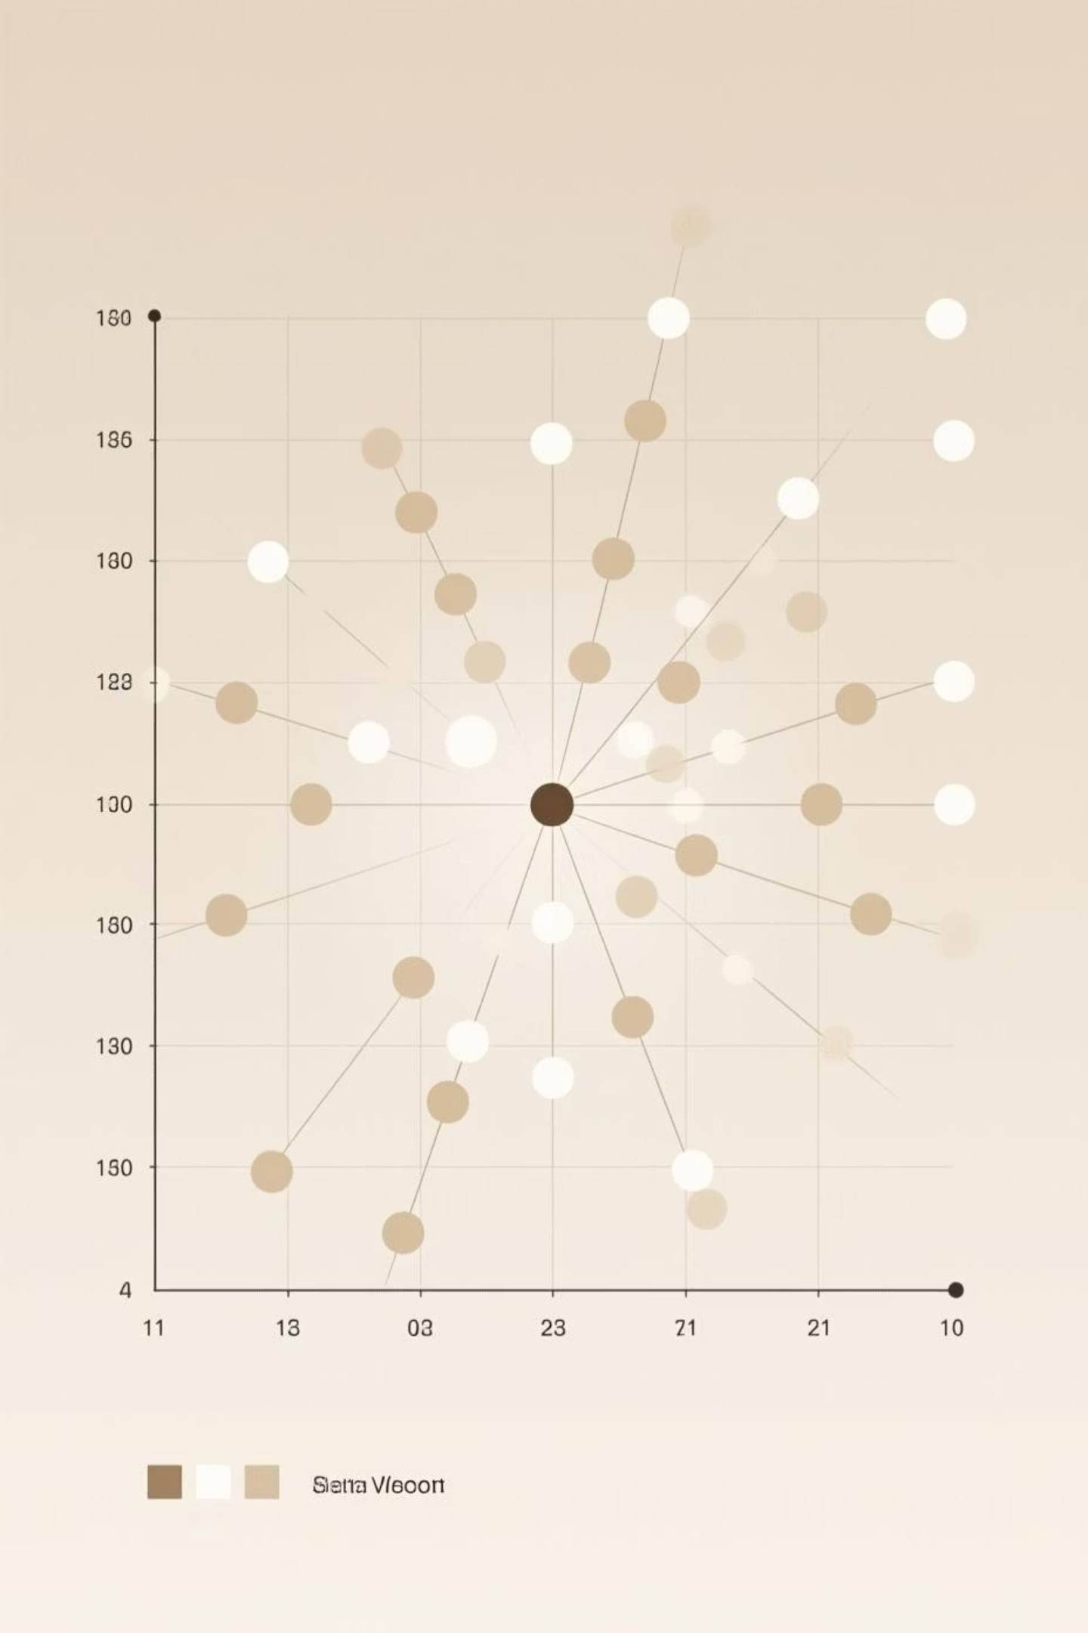
Understanding Data Outliers
Data outliers are observations that lie an abnormal distance from other values in a random sample from a population. They can occur due to measurement errors, data entry errors, or they can be genuine, rare occurrences.
Properly identifying and handling outliers is crucial for accurate model performance and risk assessment.

Slide 7
The Importance of Backtesting
Backtesting is a crucial step in validating any financial model. It involves testing a strategy or model using historical data to determine its accuracy and profitability.
01
02
03
Historical Data Application
Performance Evaluation
Risk Assessment
Apply the model to past market conditions.
Assess how the model would have performed.
Identify potential weaknesses and risks under various market shocks.
A thorough backtest helps build confidence in the model's robustness.

Slide 8

Defining Risk Tolerance
Risk tolerance is the degree of variability in investment returns that an investor is willing to withstand. It's a critical factor in making investment decisions.
Conservative Profile
Volatile Returns
Stable Returns
Investment Goals
Risk-Return Tradeoff
Low Risk Tolerance
High Risk Tolerance
Formally defining our risk tolerance will guide the final decision on which model scenario to implement.

Slide 9



Next Steps: Deep Dive into Alt_Outlier Scenario
To ensure we make the most informed decision, the next phase will focus on a comprehensive analysis of the alt_outlier scenario.
Detailed Backtest
Sensitivity Analysis
Scenario Planning
Simulate performance during historical market downturns and periods of high volatility.
Examine how small changes in outlier definition impact returns and risk.
Develop best-case and worst-case scenarios for the alt_outlier model.

Slide 10

Final Review and Decision
The insights gained from the deep dive will be presented at a final review meeting.
This meeting will be crucial for:
Reviewing backtest results and risk assessments.
Confirming the organization's risk tolerance.
Making a definitive decision on the final model implementation.
We aim to schedule this review for next week to ensure timely implementation.

